Slide 1

Currency Converter
Presented by: Swathi Ancha
23761A1269

Slide 2
Project Overview
Currency Converter is a web application used to convert currencies.
It retrieves exchange-rate information using the Frankfurter API.
Users can select source and target currencies.
It provides additional features such as currency swapping, favorites, conversion history, dark mode, and historical charts.
The application supports desktop and mobile screens.
Example:
A user wants to convert ₹1,000 into US dollars. The user selects INR as the source currency and USD as the target currency. The application retrieves the exchange rate and calculates the equivalent amount.

Slide 3
Problem Statement and Proposed Solution
Problem Statement
Manually searching for exchange rates takes time.
Calculating conversions manually can lead to errors.
Users may need to switch between different websites to compare currencies.
Proposed Solution
Provide a single interface for currency conversion.
Retrieve exchange-rate data through an API.
Calculate converted amounts automatically.
Provide useful tools such as favoruites, history, and charts.
Example:
If a student plans to purchase a product priced at $50, the application can estimate its value in Indian rupees using the available exchange rate.

Slide 4
Key Features
Feature | Description
Currency conversion | Converts amounts between supported currencies
Live/reference exchange rates | Retrieves available rates from the API
Currency swap | Reverses the source and target currencies
Currency flags | Helps users identify currencies visually
Quick amount buttons | Makes entering common amounts easier
Favorites | Saves frequently used currency pairs
Conversion history | Displays recent conversions
Dark mode | Switches between light and dark themes
Historical chart | Visualizes historical exchange-rate data
Responsive design | Adapts to different screen sizes

Slide 5


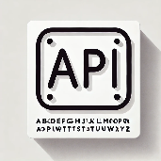

Technologies Used
HTML
CSS
JavaScript
Fetch API
Defines the structure of the webpage, including input fields, currency selectors, buttons, and result areas.
Styles the application with colors, layouts, animations, responsive design, and dark mode.
Handles user interactions, API requests, currency conversion calculations, and interface updates.
Fetch API requests exchange-rate data, Chart.js displays historical trends, and LocalStorage can preserve favourites or history in the browser.

Slide 6
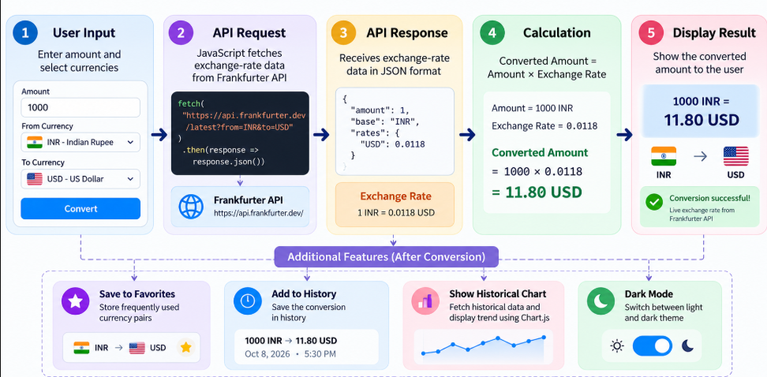
How The Application Works

Slide 7
API Integration and Project Structure
API used: Frankfurter API
Website: https://api.frankfurter.dev/
The API provides exchange-rate data that the application can use for conversion calculations and historical visualizations.
Example of the conversion logic :
const convertedAmount = amount * exchangeRate;
Here, amount is the amount entered by the user, and exchangeRate is the rate obtained for the selected currency pair.

Slide 8
Challenges Faced and Learning Outcomes
Challenges Faced
Handling API failures and loading delays.
Making the layout responsive across different screen sizes.
Updating the interface when users change currencies.
Displaying historical data clearly in a chart.
Example:
If an API request fails because of a network problem, the application should display an error message instead of showing an incorrect conversion result.

Slide 9
Live Demo, Future Scope
Live Demo: Currency Converter Application
GitHub Repository: View Source Code
Future Enhancements
Improve accessibility and keyboard navigation.
Add clearer API failure and offline messages.
Provide export options for conversion history.
Enhance historical data comparison and visualization.

Slide 10
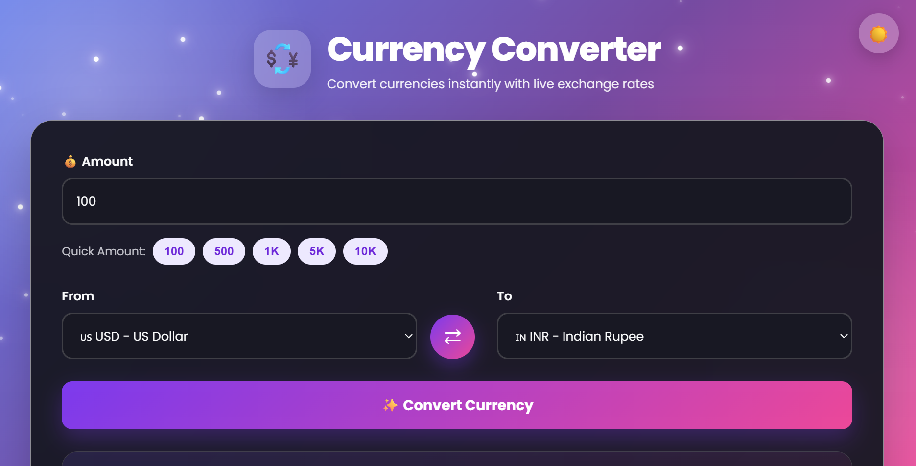
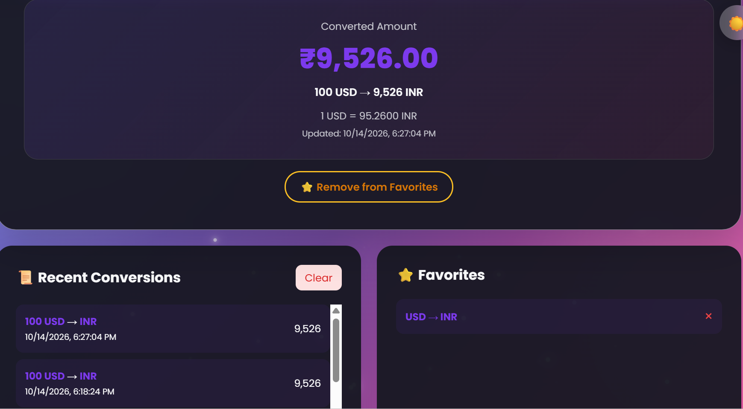
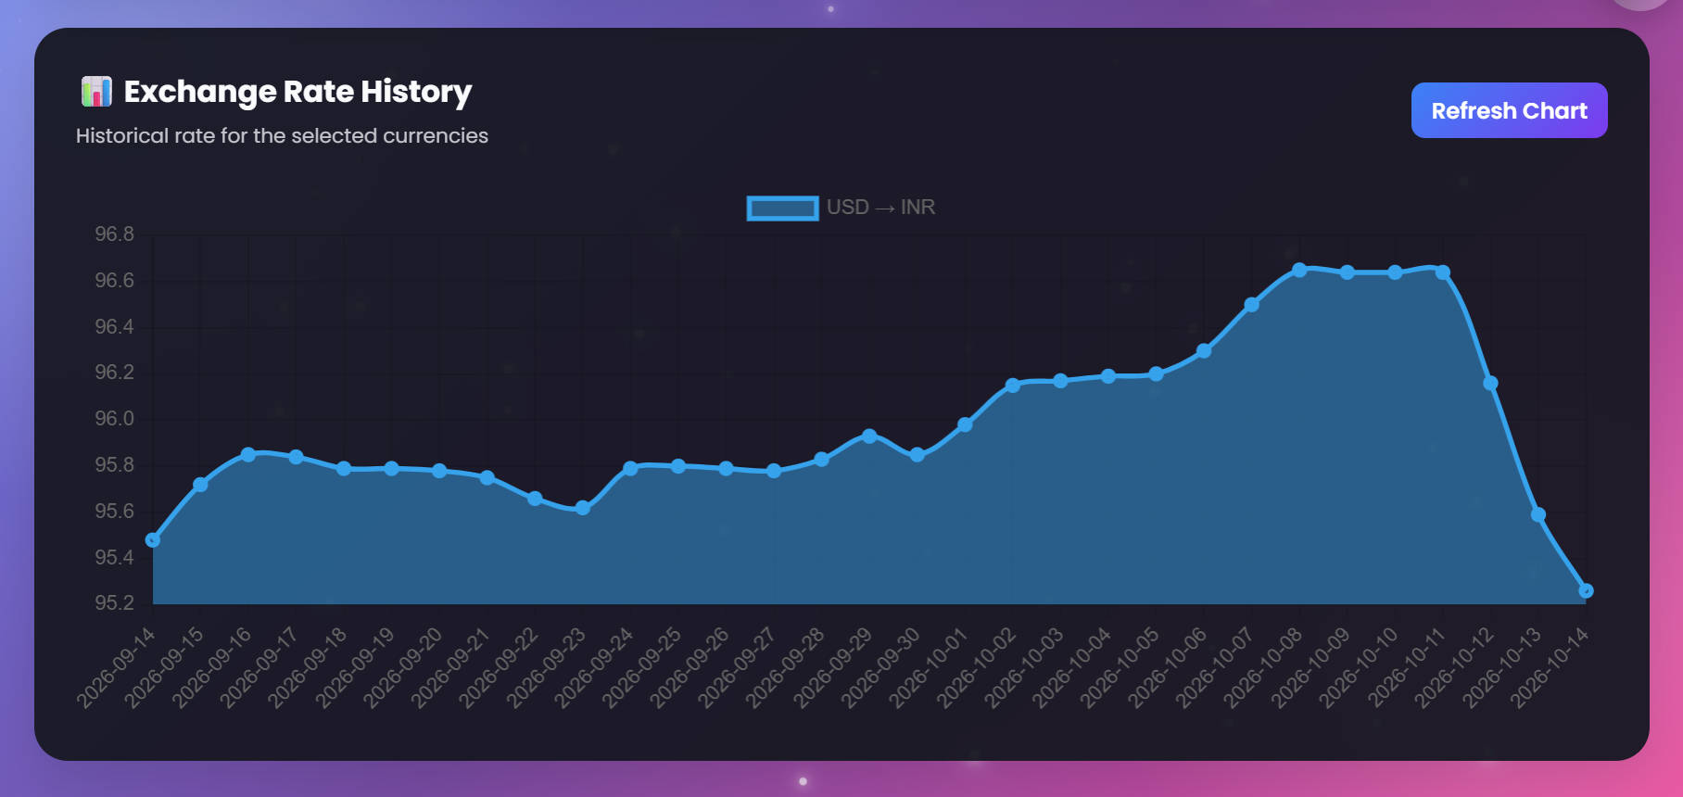
Conclusion
Built a responsive currency conversion web application.
Integrated exchange-rate data using an external API.
Implemented conversion and convenience features.
Gained practical experience in frontend development and API integration.

Slide 11


